Slide 1
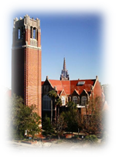
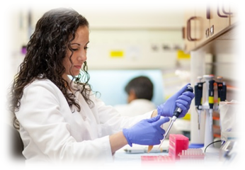
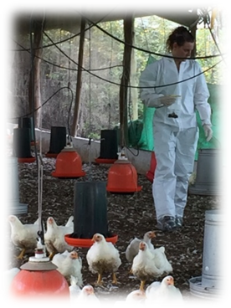
Welcome New Graduate Students
MS student | Country | Mentor, Department | PhD student | Country | Mentor, Department
Juliana BURT | USA | P Davenport, PS | Ashley BARRATCLOUGH | UK | R Francis-Floyd, LACS
Sierra CHANUTIN | USA | D Freeman, LACS | Elizabeth BRAMMER-ROBBINS| USA | C Martyniuk, PS
Victoria CICCHIRILLO | USA | R Milner, SACS | Segundo CASARO | Argentina | K Galvão, LACS
Tomas GONZALEZ | USA | R Bisinotto, LACS | Shahrzad EZZATPOUR* | Iran | J Yamamot, IDI
Twisha JANI | USA | D Santoro, SACS | Chaitanya GOTTAPU* | India | S Kariyawasam, CDPM
Ameer MEGAHED | Egypt | J Bittar, LACS | David KIIZA | Rwanda | J Hernandez, LACS
Jacob MORRIS | USA | C Plummer, SACS | Mallory LLEWELLYN | USA | T Baker, PS
Jessica PRIMM | Brazil | K Galvão, LACS | Dorothea MEGARANI | Indonesia | T Waltzek, IDI
Francesca SOLARI | USA | B Case, SACS | Nicole NAZARIO | Puerto Rico | R Dinglasan, IDI
Natalie WORDEN | USA | J Bertran, SACS | Roshen NEELAWALA | Sri Lanka | S Kariyawasam, CDPM Na SUN | China | R Dinglasan, IDI
Notes:
_

Slide 2
UF CVM Office for Research & Graduate Studies
Welcome CVM Graduate Students David Pascual, PhD
Associate Dean for Research & Graduate Studies
August 16, 2021
Notes:
_

Slide 3
Time
900 | Welcome Remarks: David Pascual, Associate Dean for Research & Graduate Studies
905 | Vet Graduate Student Association: PhD student Elizabeth Brammer-Robbins
915 | New students: Two-minute Self-Introductions
945 | UF Career Connections Center: Matthew Cowley
1005 | UF Library Resources: Hannah Norton
1015 | UF Counseling & Wellness: Ebony Okafor
1030 | BREAK
1040 | Graduate Assistants United: Rachel Harnett and Amanda Pritzlaff
1055 | CVM Graduate Programs Overview: Jorge Hernandez
1100 | Small Animal Clinical Sciences: Dan Lewis
1105 | Large Animal Clinical Sciences: Iske Larkin
1110 | Infectious Diseases & Immunology: David Allred
1115 | Comparative, Diagnostic & Population Medicine: Heather Walden
1120 | Physiological Sciences: John Bowden
1125 | Introduction: Sara Rubinstein
1130 | Summary: Jorge Hernandez
Agenda

Slide 4
Graduate Education in the College of Veterinary Medicine – Unique Opportunity
unique time in your education to focus a single problem
have insights from different scientific disciplines to enhance your research
to develop and enhance oral presentation skills
research seminars
journal clubs
local, national, & international meetings to present your research
to develop and enhance written communication skills
examinations
grant proposals
dissertation/thesis
manuscripts
learn from your mentor
interact with colleagues
learn how to manage deadlines and workloads
learn to be independent

Slide 5
Graduate Essentials
registration deadline: Aug. 28 and drop-add by Sept. 4
form your dissertation committee in the first semester
mentor & committee will dictate which graduate courses needed for your research
90 semester credits for PhD student
committee will determine format for Ph.D. candidacy which may involve an exam and/or research grant proposal
Develop your Individual Development Plan (IDP) – a working, annual document between you and your mentor to set goals for completion of degree (templates available at http://graduateschool.ufl.edu/faculty--staff/resources/individual-development-plan-idp-policy/)
MS students require at least 30 semester credits
PhD students: expect to complete this program within 4-5 years
MS students: expect to complete this program within 2-3 years

Slide 6
Veterinary Graduate Students Association
Elizabeth Brammer-Robbins PhD student, VGSA president
Notes:
_

Slide 7
Veterinary Graduate Student Association (VGSA)
https://research.vetmed.ufl.edu/studies/vgsa/
VGSA email: UFCVMVGSA@GMAIL.COM
President: Liz Brammer-Robbins
e.brammerrobbins@ufl.edu
Research &
Speaker events
Student
advocacy
Monthly
meetings & socials

Slide 8
New Students Two-Minute Self-Introductions
MS student | Country | Mentor, Department | PhD student | Country | Mentor, Department
Juliana BURT | USA | P Davenport, PS | Ashley BARRATCLOUGH | UK | R Francis-Floyd, LACS
Sierra CHANUTIN | USA | D Freeman, LACS | Elizabeth BRAMMER-ROBBINS| USA | C Martyniuk, PS
Victoria CICCHIRILLO | USA | R Milner, SACS | Segundo CASARO | Argentina | K Galvão, LACS
Tomas GONZALEZ | USA | R Bisinotto, LACS | Shahrzad EZZATPOUR* | Iran | J Yamamot, IDI
Twisha JANI | USA | D Santoro, SACS | Chaitanya GOTTAPU* | India | S Kariyawasam, CDPM
Ameer MEGAHED | Egypt | J Bittar, LACS | David KIIZA | Rwanda | J Hernandez, LACS
Jacob MORRIS | USA | C Plummer, SACS | Mallory LLEWELLYN | USA | T Baker, PS
Jessica PRIMM | Brazil | K Galvão, LACS | Dorothea MEGARANI | Indonesia | T Waltzek, IDI
Francesca SOLARI | USA | B Case, SACS | Nicole NAZARIO | Puerto Rico | R Dinglasan, IDI
Natalie WORDEN | USA | J Bertran, SACS | Roshen NEELAWALA | Sri Lanka | S Kariyawasam, CDPM Na SUN | China | R Dinglasan, IDI
Notes:
_

Slide 9
UF Career Connections Center
Matthew Cowley Manager for Integrated Partnerships
Notes:
_

Slide 10
UF Library Resources
Hannah Norton Liaison Librarian to CVM
Notes:
_

Slide 11
CVM Counseling and Wellness
Ebony Okafor Outreach Coordinator
Notes:
_

Slide 12
UF Graduate Assistants United
Rachel Harnett
Amanda Pritzlaff Co-President
Chemistry Dept. Steward
Notes:
_

Slide 13
CVM Graduate Programs
Jorge Hernandez Professor and Director of Graduate Education
hernandezja@ufl.edu 352 294 4305

Slide 14
UF Health
UF Health Science Center
Dentistry
Medicine
Nursing
Pharmacy
Public Health & Health Professions
Veterinary Medicine

Slide 15
UF College of Veterinary Medicine
CVM Dean’s Office
Office for Academic & Student Affairs
CD&PM Dr. Kariyawasam Dr. Long
ID&I Dr. Moore Dr. Allred
Office for Research & Graduate Studies
Physiol Sci Dr. Cooke Dr. Bowden
LACS Dr. Freeman Dr. Larkin
SACS Dr. Adin Dr. Santoro

Slide 16
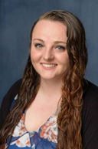
CVM Office for Research & Graduate Studies
Associate Dean for Research & Graduate Studies Dr. David Pascual
Contracts & Grants
Director of Clinical & Translational Research Dr. Rowan Milner
Director of Graduate Education Dr. Jorge Hernandez
Academic Program Specialist Ms. Sara Rubinstein
s.rubinstein@ufl.edu

Slide 17
CVM Office for Research & Graduate Studies
CVM Office Grad Ed
CVM Grad Studies Committee
UF Grad School
Students & VGSA

Slide 18
CVM Office for Research & Graduate Studies Student Demographics 2020-2021 N = 54

Slide 19
CVM Office for Research & Graduate Studies Student Demographics 2020-2021 N = 54

Slide 20
CVM Office for Research & Graduate Studies Student Demographics 2020-2021 N = 54
Brazil China Egypt India Japan Mexico Nigeria Paraguay Taiwan Thailand Uruguay

Slide 21
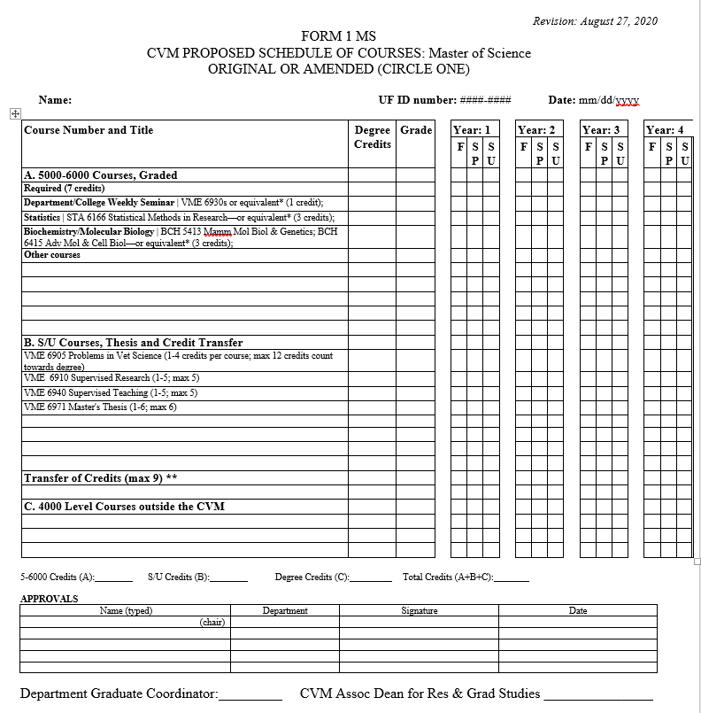
MSc Coursework: 30 credits
Required
Statistics (3 credits)
Molecular Biology (3)
Graduate Seminars (1)

Slide 22
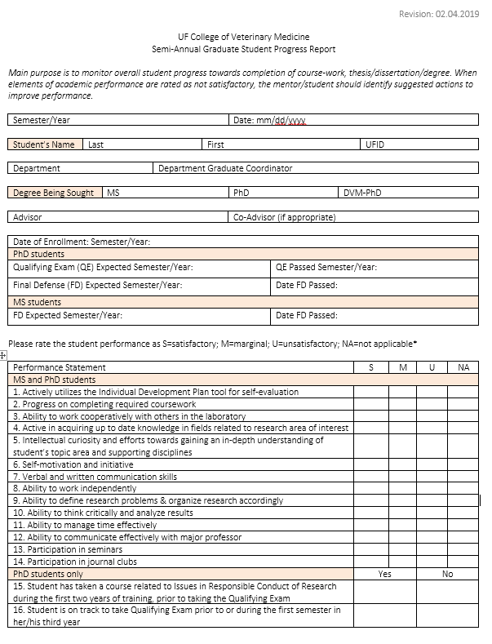
Semi-Annual Graduate Student Progress Report
To monitor overall student progress …
Academic performance
Satisfactory
Marginal
Unsatisfactory
Not applicable

Slide 23
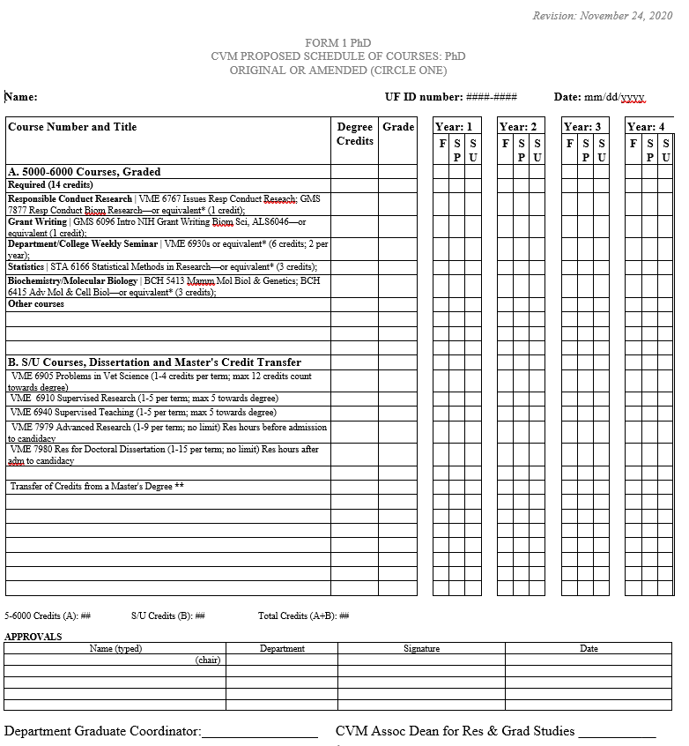
PhD Coursework: 90 credits
Required
Research Ethics (1 credit)
Grant Writing (1)
Statistics (3)
Molecular Biology (3)
Graduate Seminars (6)

Slide 24
Individual Development Plan
A tool to help support, plan, and track your career development and learning opportunities
Knowing/Assessing Self
Exploring Options (career paths), prioritize skills
Setting SMART Goals
Implementing the Plan
http://graduateschool.ufl.edu/faculty--staff/resources/individual-development-plan-idp-policy/

Slide 25
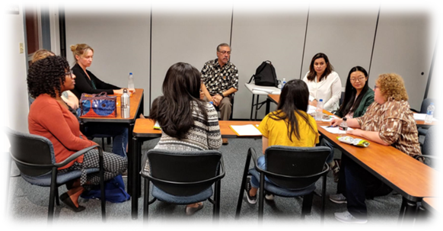
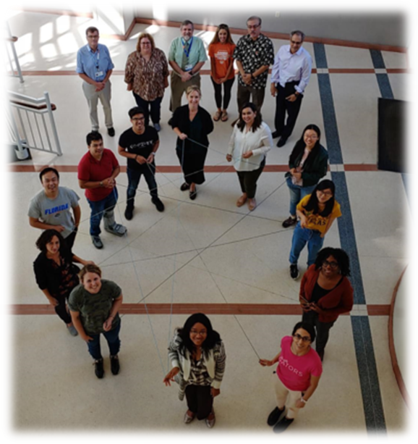
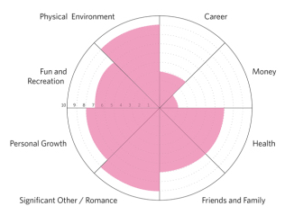
Professional Skills Collaboration | Communication | Leadership | Mentoring | Research Management | Teaching | Writing
Office of Biomedical Research Career Development https://graddev.ufhealth.org/professional-skills/
The Art of Giving Feedback
Active Listening
Resolving Conflict Situations
Communication
Personal Values, Wheel of Life
Developing Your Five-Year Plan

Slide 26
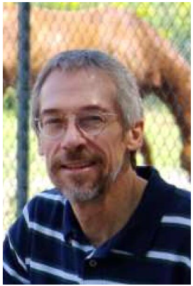
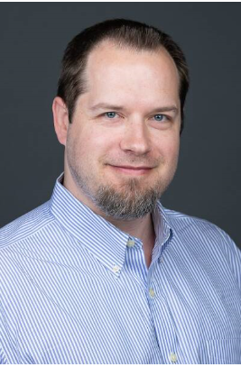
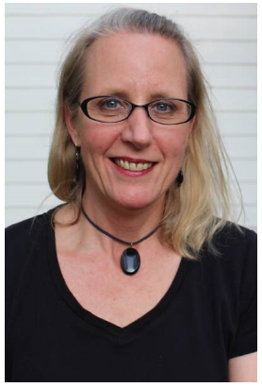
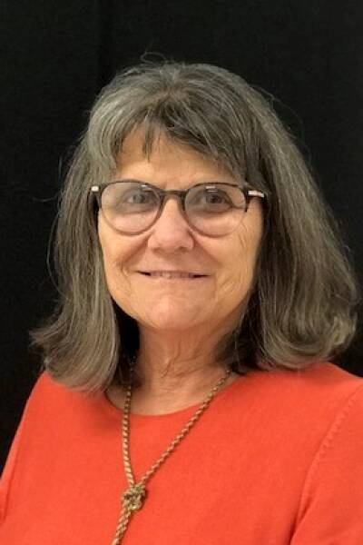
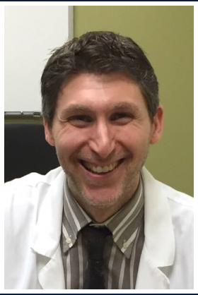
CVM Department Graduate Coordinators
Infect Dis & Immunol | Dr. Allred Physiol Sci | Dr. Bowden Lg Anim Clin Sci | Dr. Larkin Comparative Diag & Pop’n Med | Dr. Long Sm Anim Clin Sci | Dr. Santoro

Slide 27
Small Animal Clinical Sciences
Dan Lewis Distinguished Professor
for
Domenico Santoro Associate Professor and Department Graduate Coordinator
Notes:
_

Slide 28
Large Animal Clinical Sciences
Iske Larkin Lecturer and Department Graduate Coordinator
Notes:
_

Slide 29
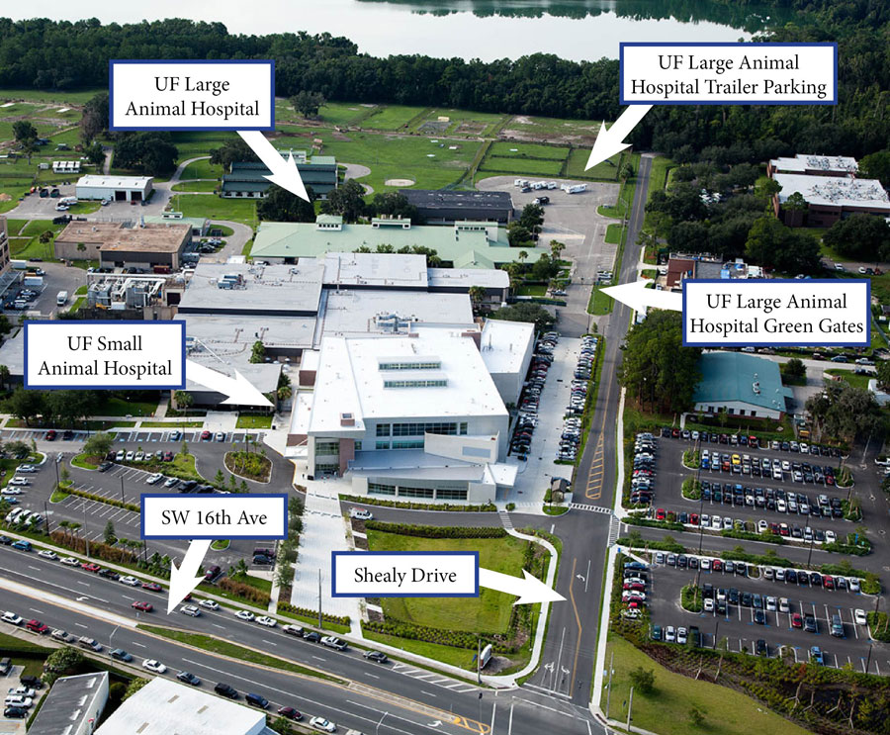

Slide 30
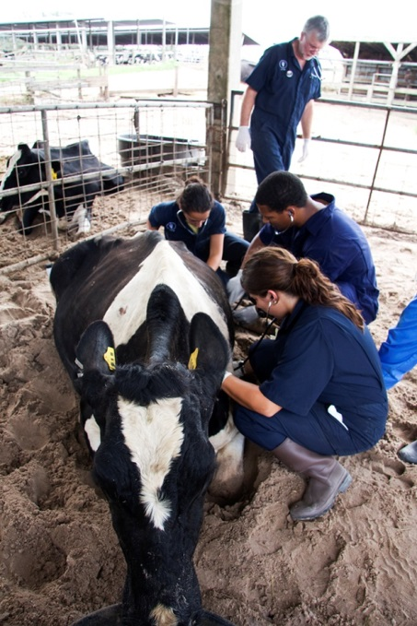
Large Animal Clinical Sciences | Services
Aquatic Animals
Food Animal Repro & Med
Large Animal Medicine
Large Animal Surgery
Theriogenology (Reproduction)
Clinical training
Extension (Beef, Dairy, Deer, Horses, Poultry, Aquatics, Small Ruminants)
Research
Graduate Faculty :28
For 2020-2021
7 MS
8 PhD

Slide 31
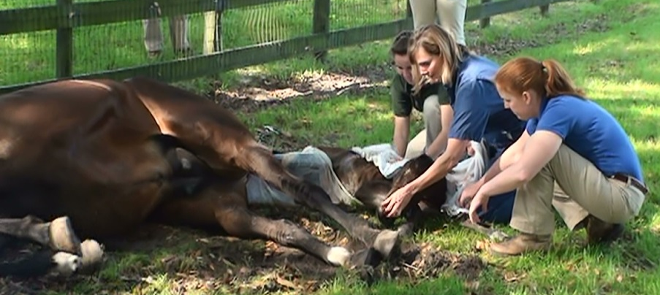
LACS Research
Equine
Gastrointestinal physiology and pathophysiology - Drs. Freeman, and Bauck
Reproduction - Stallion infertility - Dr. Pozor; Mare infertility – Dr. Macpherson
Musculoskeletal disease – Drs. McCarrel and Biedrzcki
Pharmacokinetics and Pharmacodynamics – Dr. McCarrel
Cardiology – Dr. Adin
Neonatology, neurology, infectious disease, hemostatic therapies, and colic– Dr. DeNotta
Notes:
Department support: laboratories, technicians (biological scientists)
Grant funding: various intramural and extramural sources

Slide 32
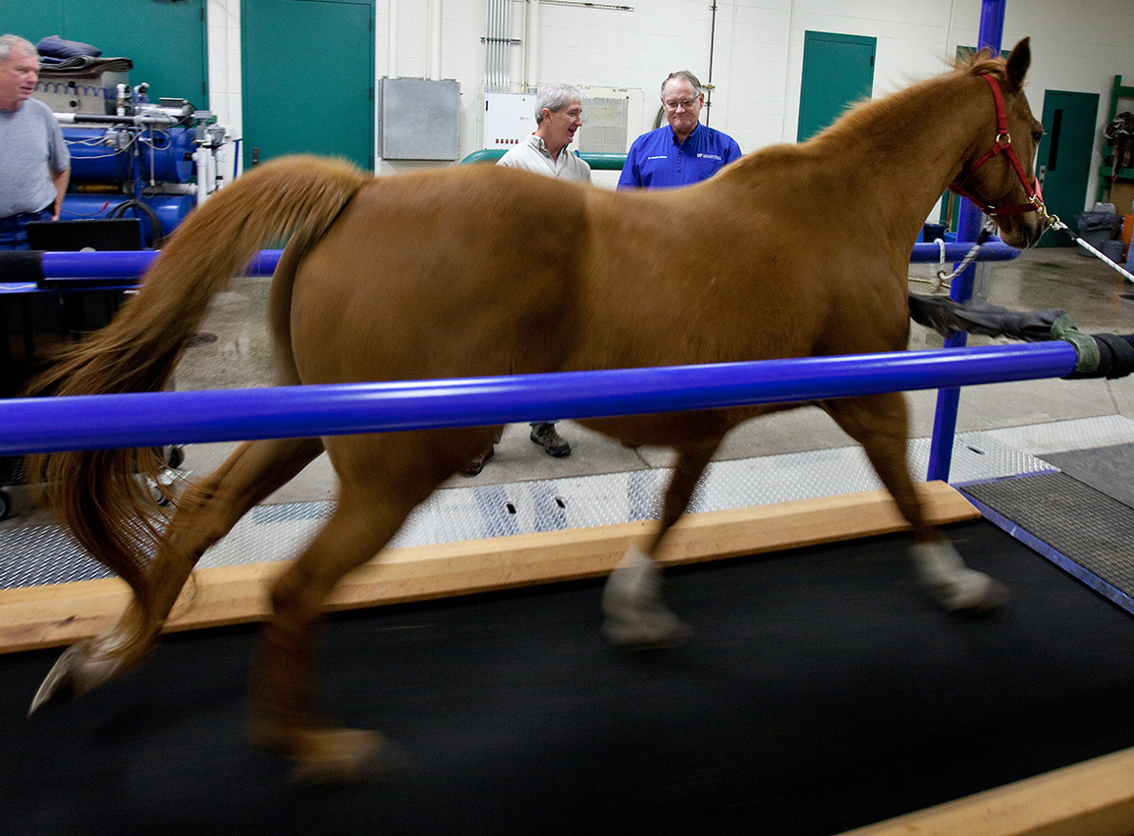
UF Equine Performance Laboratory
Studies the effects of drugs on athletic performance in race horses - Dr. McCarrel

Slide 33
LACS Research
Beef and Dairy Cattle Research
Infectious diseases – Dr. Rae
Mycobacterium avium ssp. paratuberculosis & Tritrichomonas foetus
Mycoplasma bovis infections and mastitis - Dr. Maunsell
Reproductive management in dairy cattle – Drs. Galvao, Bisinotto and Chebel
Dairy Welfare – Dr. Chebel
Calf immunology and disease – Dr Bittar
Epidemiology of diseases in animal and human populations – Drs. Denagamage, Hernandez, and Isaza
Deer diseases – Dr. Campos
Goat and Sheep diseases – Dr. Cabrera
Poultry diseases – Dr. Butcher

Slide 34
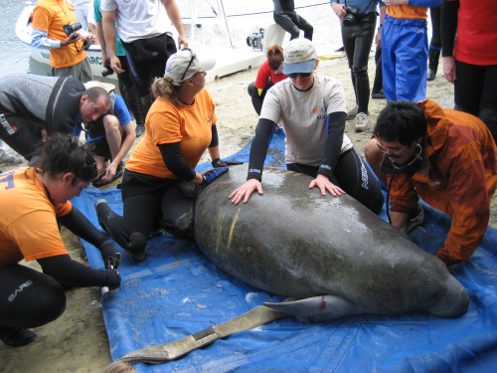
LACS Research
Aquatic Animal Health
Aquaculture, Aquarium and Fish Health
Emerging Pathogens and Infectious Diseases
Dolphin nutrition, microbiome & oncology
Manatee
Reproduction
Toxicology
West African Manatees
Genetics
Proteomics, lipidomics, metabolomics
Scholarship of Teaching and Learning
Notes:
While Aquatics is housed in LACS, it is an interdisciplinary program and has faculty participating from all of the CVM departments

Slide 35
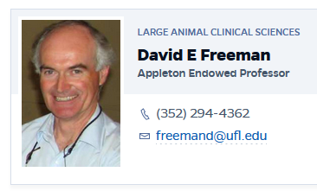
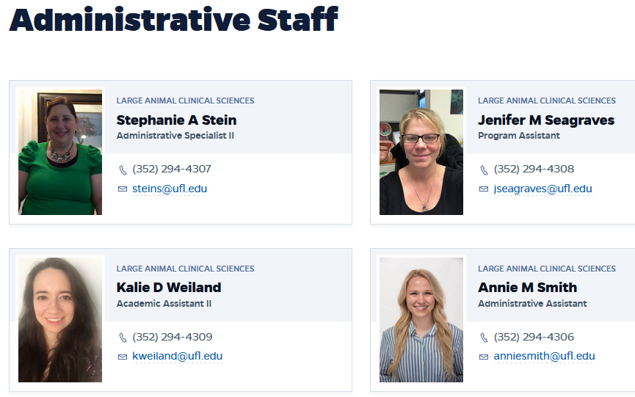
LACS Departmental Support
Dr David Freeman – Professor and Interim Department Chair
https://lacs.vetmed.ufl.edu/faculty-and-staff/administrative-staff/

Slide 36
Tips and Tricks
Plan ahead for committee meetings (herding cats)
Take minutes
Introduce yourself to Staff in Dept – who to go to for fiscal questions and travel forms
Travel grants (e-mails from the Graduate School)
UF resources; EH&S, Lab safety
Big Brother/Sister for new grad students?
College Clubs – VGSA, Alpha Psi, Aquatic Animal Health Club, dog food pick up etc…
https://lacs.vetmed.ufl.edu/

Slide 37
Infectious Diseases & Immunology
David Allred Professor and Department Graduate Coordinator
Notes:
_

Slide 38
Comparative, Diagnostic & Pop’n Medicine
Heather Walden Assistant Professor of Parasitology
for
Maureen Long Professor and Department Graduate Coordinator
Notes:
_

Slide 39
Department of Comparative Diagnostic & Population Medicine 2017
Department Chair
Subhashinie Kariyawasam
294-8794
skariyawasam@ufl.edu
VAB V2 117
Senior Administrative Assistant: Summer Pridgen
294-8795
spridgen1@ufl.edu
VAB V2 117
Graduate Coordinator
Maureen Long
294-8305
longm@ufl.edu
VAB V3-157

Slide 40
What is CDPM?
Veterinary medicine-many organized disciplines that are not allied with a veterinary hospital or have high animal flow through
CDPM- One Health Discipline, Non – Client Veterinary Services: Diagnostics, Anesthesia
Pathology and Clinical Pathology
Microbiology and Virology
Anesthesia-pain management
Wildlife
Aquatics/Fisheries/Marine Mammal
Integrative Medicine

Slide 41
CDPM Mission Statement
Benefit society and the environment by educating students, performing research, and provision of clinical service to all species with emphasis on diagnostic and consultative medicine, integrative medicine, and conservation medicine.

Slide 42
Goals
Provide cohesiveness to comparative species disciplines that are currently dispersed throughout the College.
Attain excellence in all efforts: clinical service, teaching, research, outreach.
Develop a viable graduate program.
Communication of excellence.

Slide 43
Department Facts
Faculty: 32 full time faculty
Graduate Faculty: ~25
Graduate Students: 8
5 PhD
3 Masters of Science
Welcome: Roshen Neelawala, BVSc
Mentor: Subhashinie Kariyawasam

Slide 44
Our Students!
Name | Mentor | Degree | Discipline
Roshen Neelawala | Kariyawasam | PhD | Microbiology - Salmonella
Steven Tillis | Ossiboff | PhD | AQAR/Reptile Viruses
Sarah Wahltinez | Stacy | PhD | Marine Mammal –Sea Stars
Verinoque Etienne | Long | PhD | Microbiology - Virology
Eric McCown | Long | PhD | Microbiology – Tick-borne Diseases
Amanda Sebastian | Allison | Masters | Microbiology - Virology
Megan Horowitz | Allison, Walsh | Masters | Microbiology - Virology
Mariana Bragga Cavalcanti | Portela | Masters (Resident) | Anesthesia

Slide 45
Remember if it was easy Everyone would be doing it

Slide 46
Physiological Sciences
John Bowden Assistant Professor and Department Graduate Coordinator Office: B3-27 of Basic Science Building T 294-4063 | john.bowden@ufl.edu | https://bowden.vetmed.ufl.edu/
Notes:
_

Slide 47
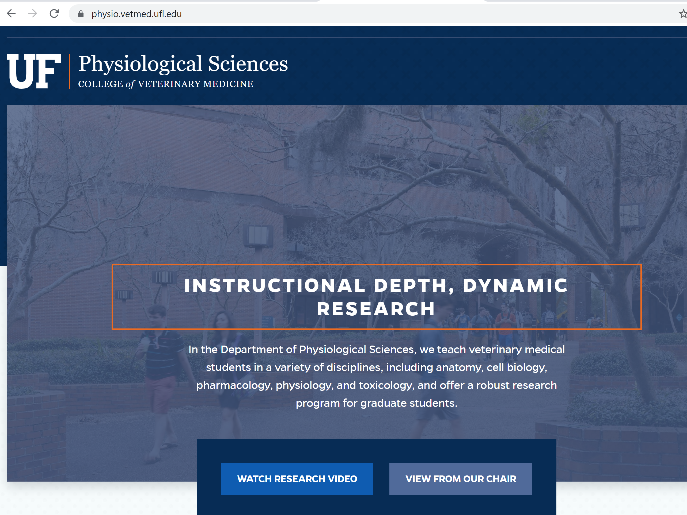
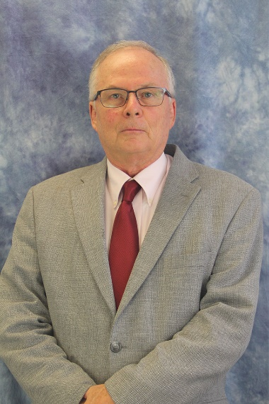
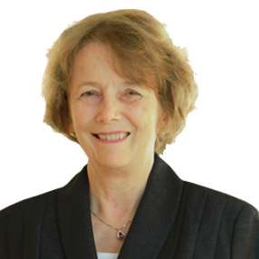
Physiological Sciences
Dr. Paul S. Cooke, Professor and Chair: paulscooke@ufl.edu
Dr. Nancy Denslow, Professor and Associate Chair: ndenslow@ufl.edu
https://physio.vetmed.ufl.edu/

Slide 48
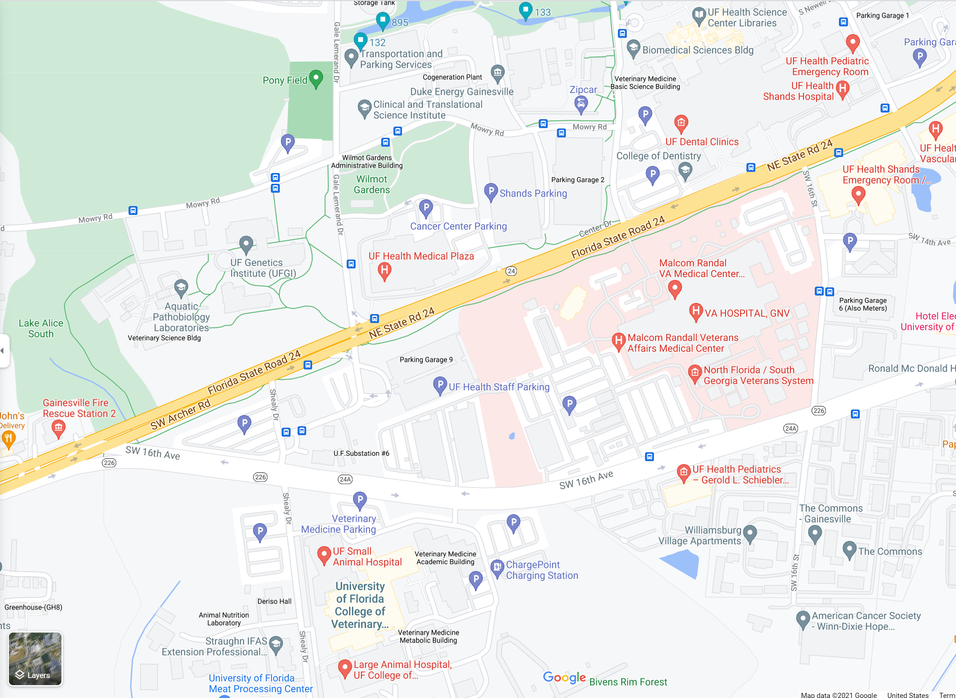
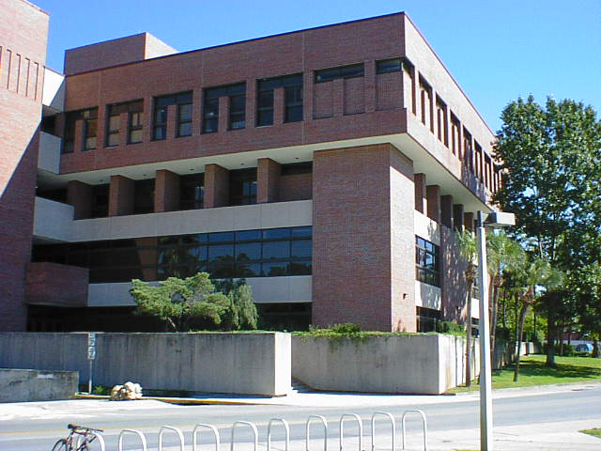
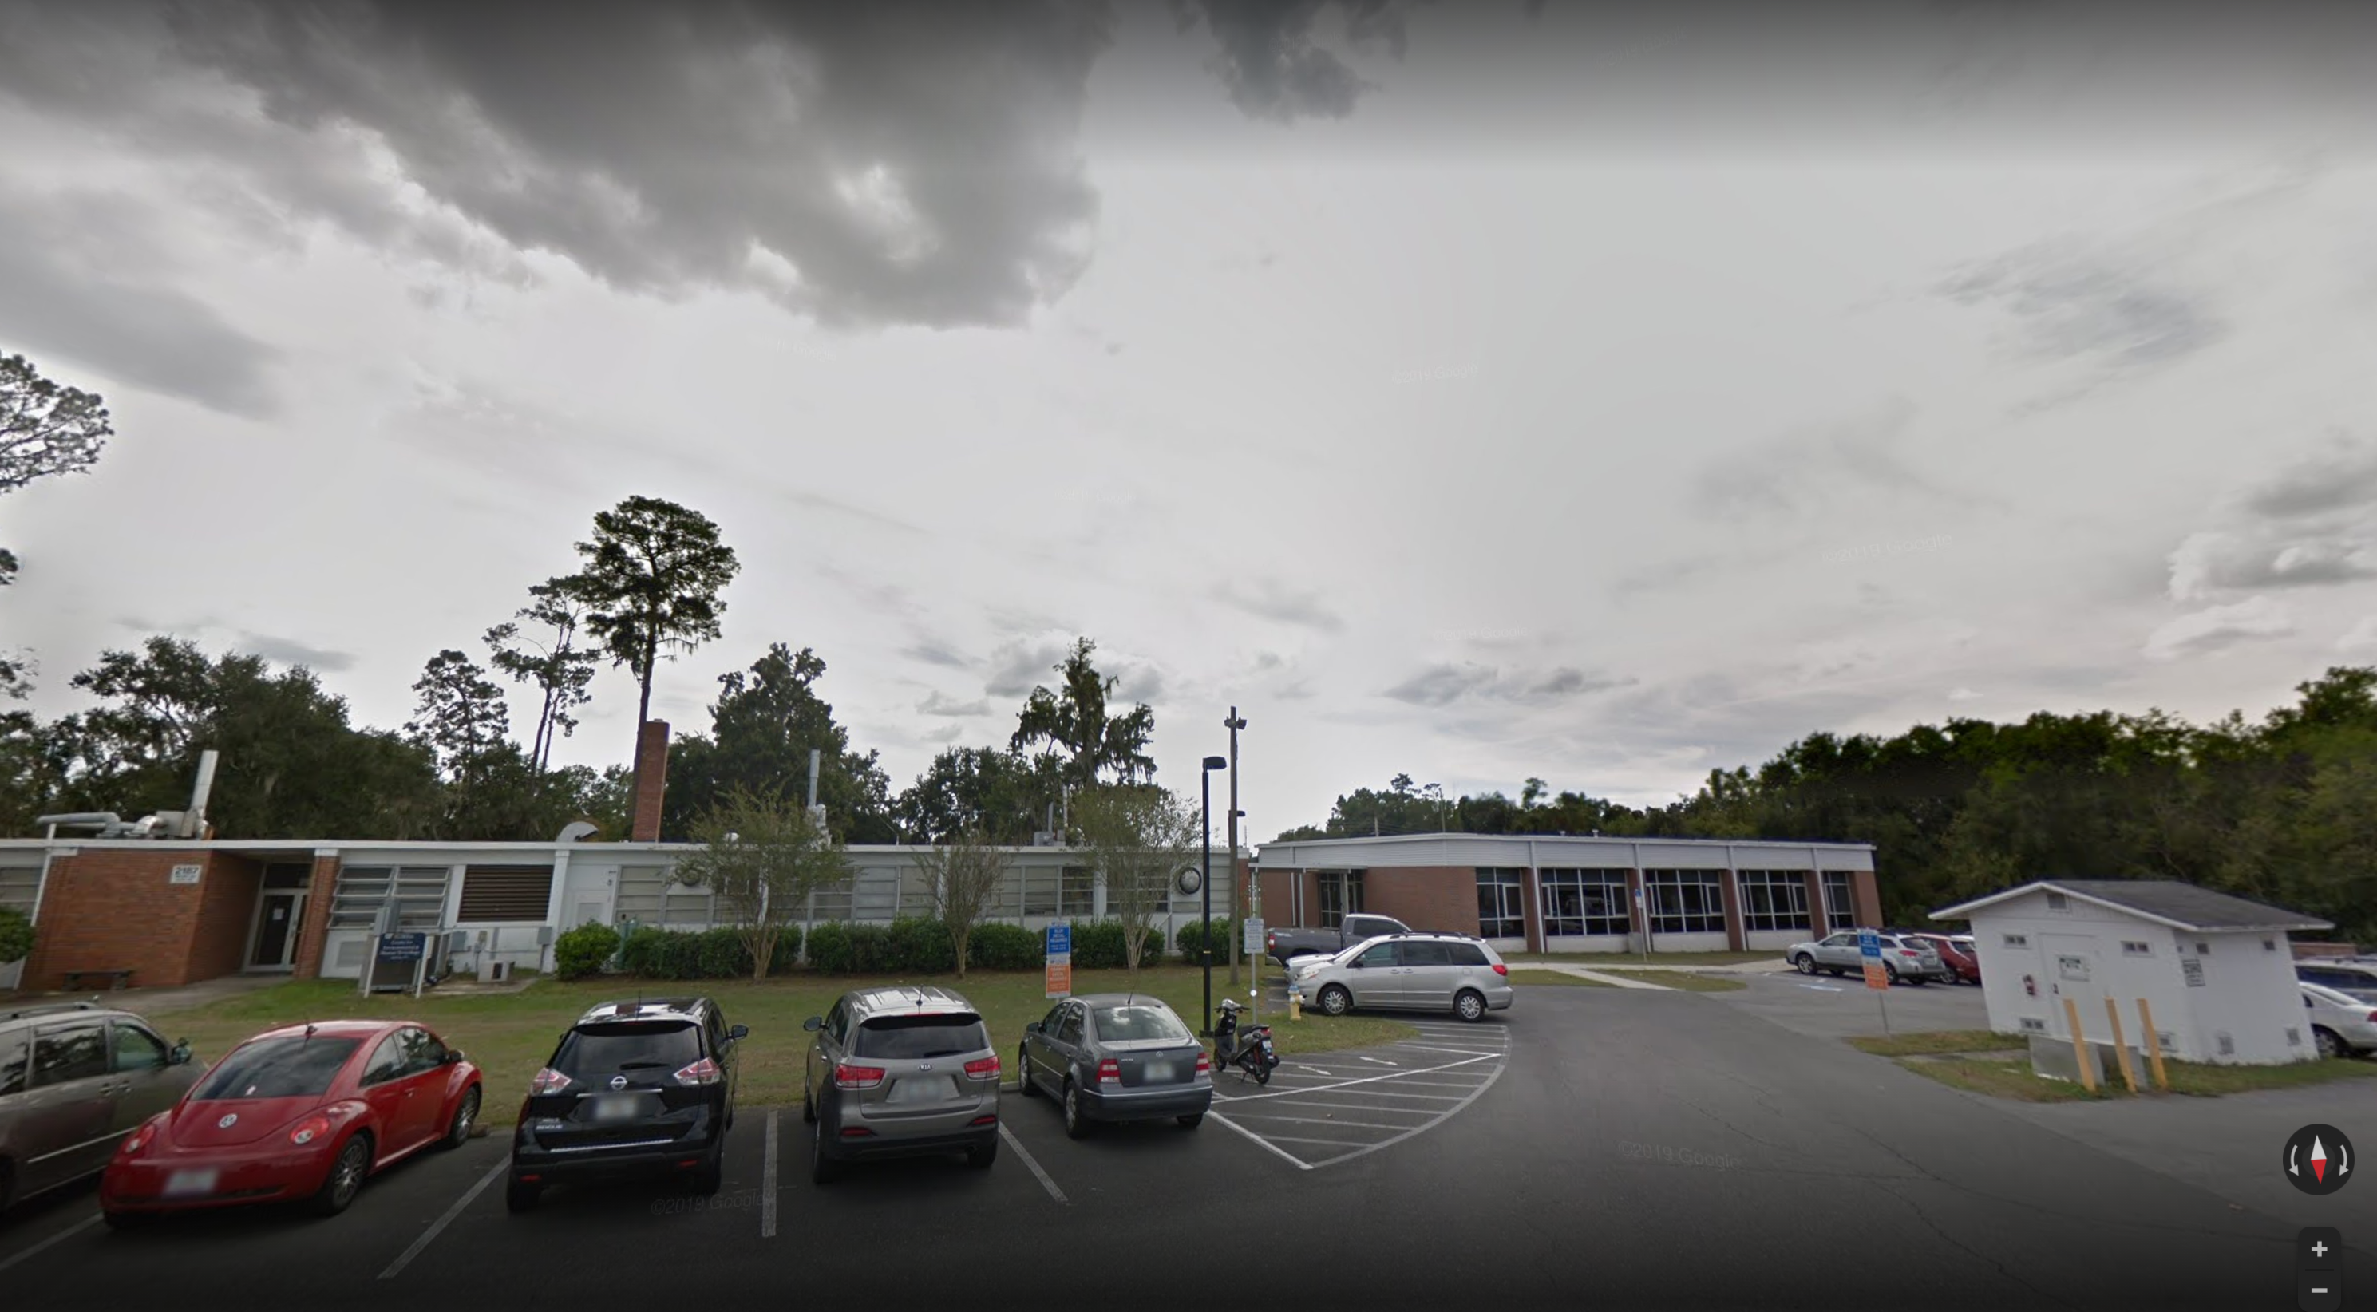
Physiological Sciences
Basic Science Building (BSB, 2nd and 3rd Floor)
Center for Human and Environmental Toxicology (CEHT)

Slide 49
Physiological Sciences
14 Faculty across both Physiology and Toxicology disciplines
8 Ph. D. graduate students, several postdoctoral students/assistants and many technical staff members
Administrative Specialist II: Laurel Arnold, laurelarnold@ufl.edu
Administrative Support Assistant II: Jennifer Green, jennifer.green@ufl.edu
https://physio.vetmed.ufl.edu/faculty-staff/faculty/

Slide 50
Fun Facts about Physiological Sciences
Active and successful research portfolio ~ 4 million in external funding last year
Diverse funding sources: NIH, USDA, NSF, the U.S. Department of Veterans Affairs, GoMRI, US EPA, DoD, FDEP, FDH and a wide variety of other intramural and extramural sources.
Interdisciplinary research is a strength of the department – stems from a collaborative environment nurtured within the department to work with other departments across campus (and with students and staff as well)
Highly recognized faculty (e.g., awards) and via scholarship (e.g., manuscripts)

Slide 51
Physiological Sciences Graduate Program
Two concentrations: Physiology and Interdisciplinary Toxicology
The major research strengths of the department are in the areas of neuroscience/neurophysiology and toxicology/pharmacology.
Research in the neuroscience/neurophysiology area includes studies of brain/spinal/peripheral nerve injury and pathology, neural control of respiration, cough, the cardiovascular system, comparative neuroanatomy, and neuromodulation. Other areas in physiology are bone metabolism and reproductive/endocrine biology.
Research in the area of toxicology/pharmacology includes toxicology, drug residues, aquatic toxicology, toxicologic risk assessment, and nanotoxicology.

Slide 52
Physiological Sciences Graduate Program: Progress toward Degree
Meet with mentor and develop and IDP (Individual Development Plan)
Take required courses (check Physio handbook), learn required techniques, begin initial/pilot studies, work on dissemination skills (creatively under current climate)
Give Physio departmental seminar (Tuesdays at 4 pm), establish Supervisory Committee (with regular meetings) and take Qualifying exam by end of 2nd year
Finalize research direction to complete thesis, complete research and write thesis/dissertation, and give final seminar and defend thesis/dissertaton
Reach out to me if questions: john.bowden@ufl.edu

Slide 53
CVM Office for Research & Graduate Studies
Sara Rubinstein Academic Program Specialist Office: CVM Academic Building T 352 294 4241 | s.rubinstein@ufl.edu
Notes:
_

Slide 54
2021 CVM Graduate Student Orientation Summary and Q&A
Welcome CVM Office for Research Graduate Studies Veterinary Graduate Student Association UF Career Connections Center UF Library Resources CVM Counseling ad Wellness UF Graduate Assistants United CVM Graduate Programs CVM Department Graduate Coordinators
Notes:
_

